Slide 1

18CSE354T - Network Security
UNIT – 3

Slide 2
Unit -3 Topics
Security Services for E-mail
Establishing keys
Establishing Public and secret keys
Privacy
End-to end Privacy, Privacy with distribution List Exploders
Authentication of the source
Based on public key technology and secret keys and with distribution list
Message Integrity
Non-repudiation
Introduction and Overviw of PGP
Efficient Encoding
Certificate and key revocation
Signature types, Private key, Fing types
Anomalies
Object Format
S/MIME
Reference :
Charlie Kaufman, Radia Perlman, Mike Speciner, Network Security, Prentice Hall of India, 2002.
Chapter 20 : Electronic Mail Security , Chapter 22 : PGP

Slide 3
ELECTRONIC MAIL SECURITY

Slide 4
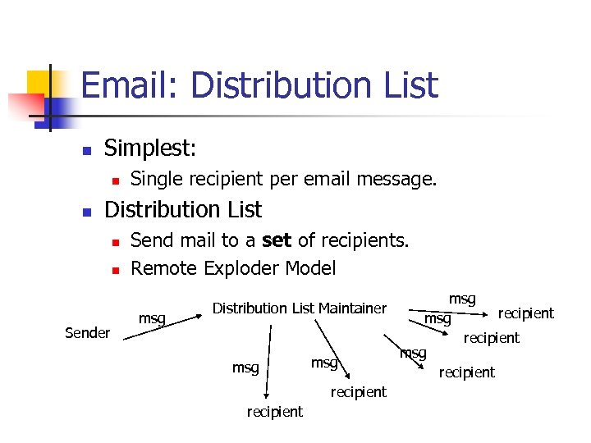
Basic Concepts : DISTRIBUTION LISTS REMOTE EXPLODER

Slide 5
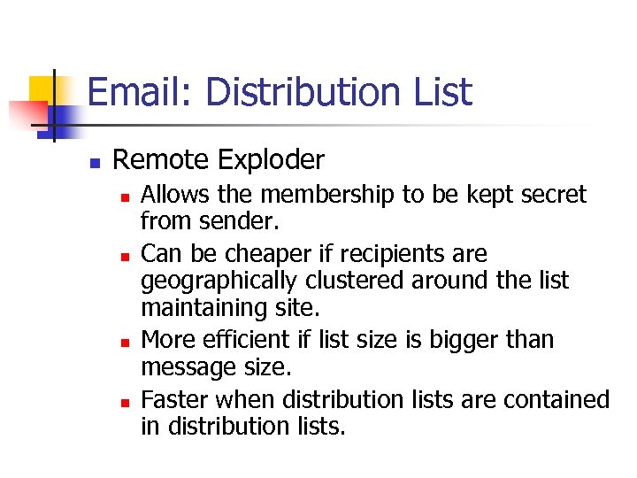
Basic Concepts : DISTRIBUTION LISTS REMOTE EXPLODER

Slide 6
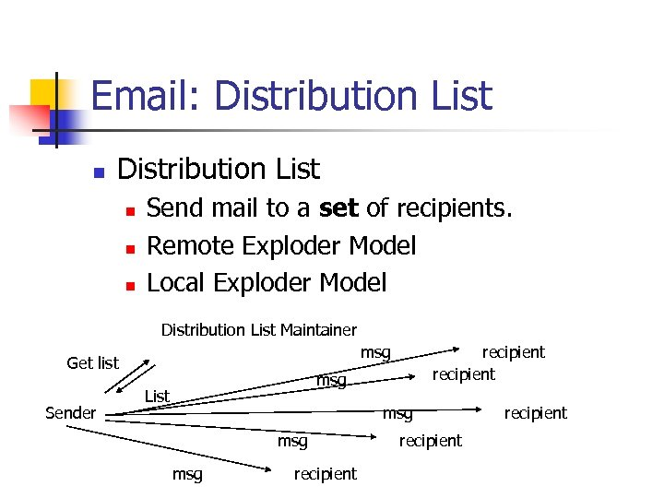
Basic Concepts : DISTRIBUTION LISTS LOCAL EXPLODER

Slide 7
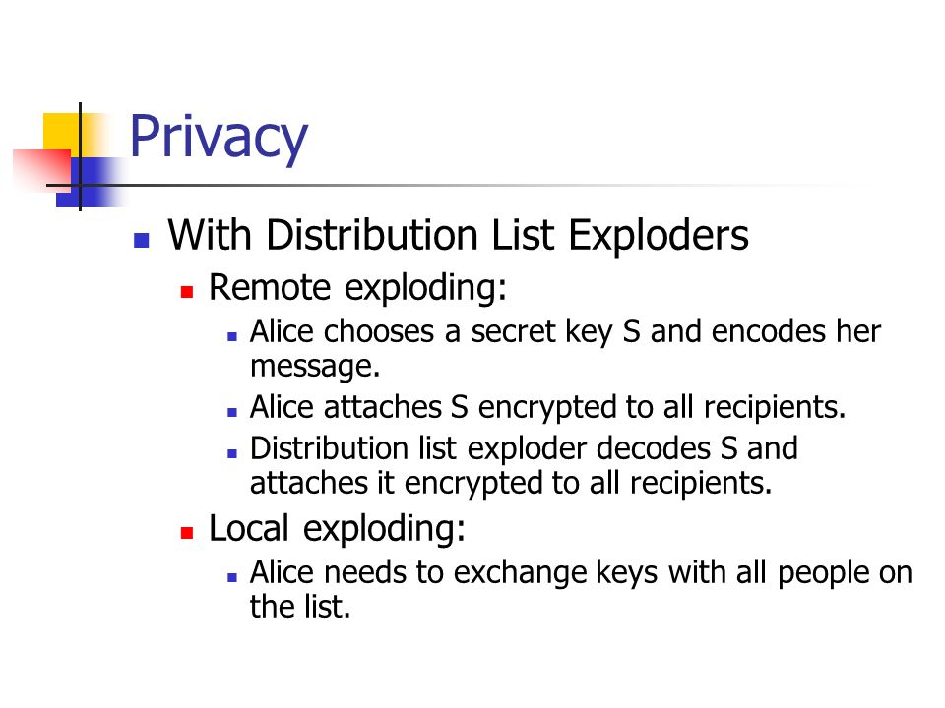
Basic Concepts : DISTRIBUTION LISTS Remote Exploder Vs Local Exploder

Slide 8
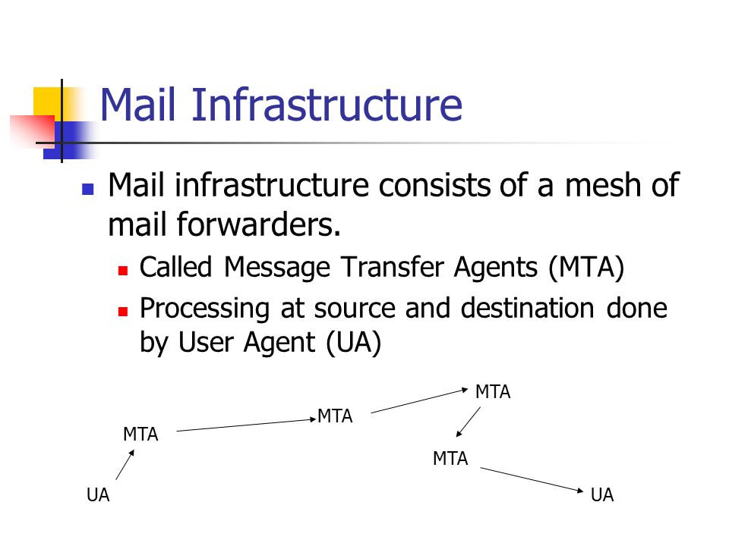
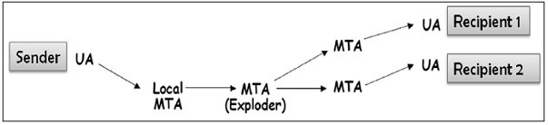
Basic Concepts : STORE AND FORWARD
(Mail Forwarding)

Slide 9
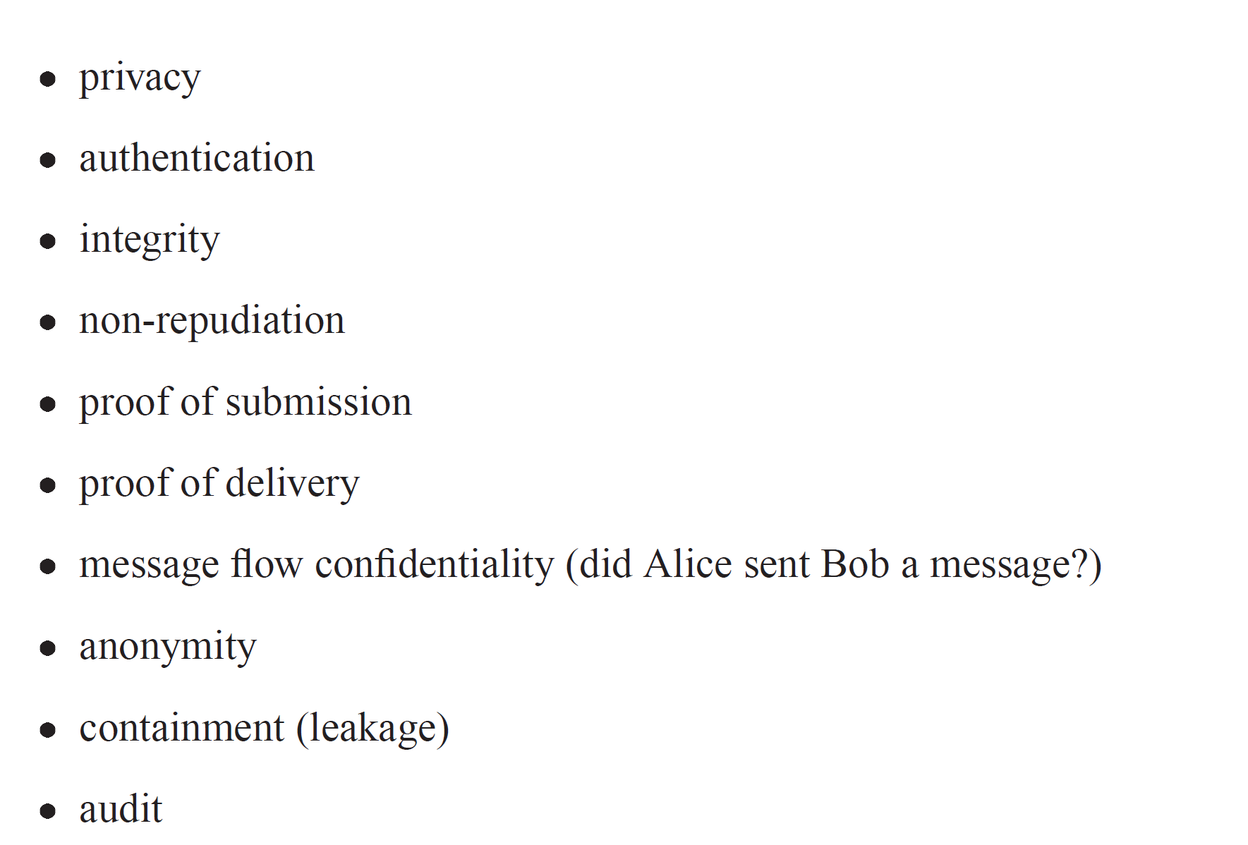
SECURITY SERVICES FOR ELECTRONIC MAIL

Slide 10
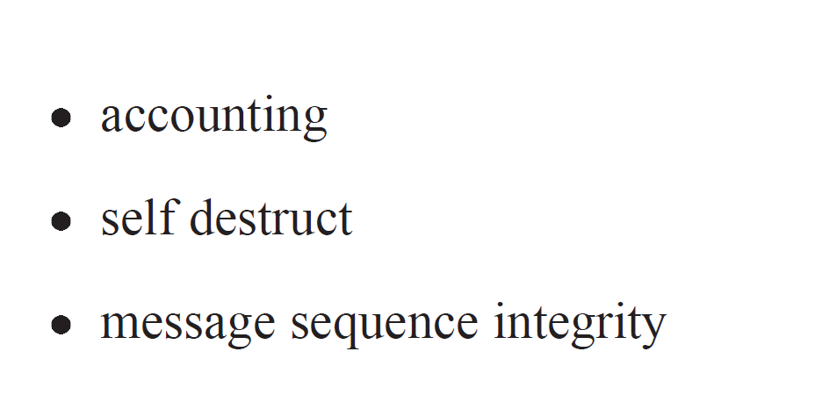
SECURITY SERVICES FOR ELECTRONIC MAIL(contd)

Slide 11
SECURITY SERVICES FOR ELECTRONIC MAIL(contd)

Slide 12
Unit -3 Topics
Security Services for E-mail
Establishing keys
Establishing Public and secret keys
Privacy
End-to end Privacy, Privacy with distribution List Exploders
Authentication of the source
Based on public key technology and secret keys and with distribution list
Message Integrity
Non-repudiation
Introduction and Overviw of PGP
Efficient Encoding
Certificate and key revocation
Signature types, Private key, Fing types
Anomalies
Object Format
S/MIME

Slide 13
Establishing keys
Establishing Public Keys
Establishing Secret Keys

Slide 14
Establishing keys-
(Establishing Public Keys)
Ex - Alice wants to send an encrypted message to Bob
Receive public key through some secure out-of-band mechanism , and install it on workstation .
Obtain through a PKI (e.g, looking it up in a directory) (Public Key Infrastructure )
The email system could allow piggybacking of certificates (and perhaps CRLs) on email messages.

Slide 15
Establishing keys-
(Establishing Secret Keys)
Ex – How can Alice and Bob establish a shared secret key for email ?
Private communication
Alice to obtain a ticket for Bob from a KDC Mediated Authentication (with KDC) , and include that ticket with her first message to Bob .

Slide 16
Unit -3 Topics
Security Services for E-mail
Establishing keys
Establishing Public and secret keys
Privacy
End-to end Privacy, Privacy with distribution List Exploders
Authentication of the source
Based on public key technology and secret keys and with distribution list
Message Integrity
Non-repudiation
Introduction and Overviw of PGP
Efficient Encoding
Certificate and key revocation
Signature types, Private key, Fing types
Anomalies
Object Format
S/MIME

Slide 17
PRIVACY
Breach to Email Privacy
Eavesdropper listening to the message during transmission on the wire if the network doesn’t provide link encryption.
Relay nodes (routers or mail forwarders) having software to store messages and divulge them to people other than the intended recipients.
Conflicting Security Needs

Slide 18
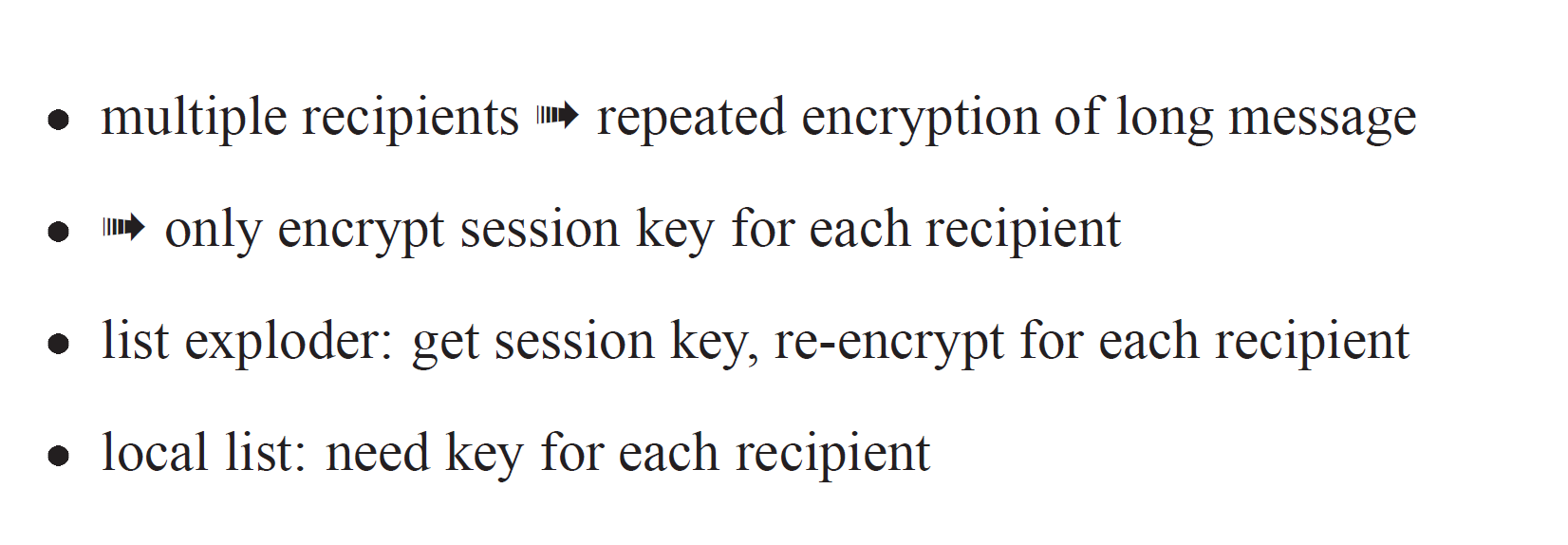
PRIVACY
End – to – End Privacy
Privacy with Distribution List Exploders

Slide 19
PRIVACY
End – to – End Privacy
Scenario : Alice might want to send a message to Bob in such a way that only Bob can read it .
Extend the scenario (Alice to multiple recipients…)
Issues
If Long message to send multiple recipients , the long message would have to be encrypted once for each recipient , producing a different version to be send to each recipient.
Public key Encryption less efficient than secret key encryption.

Slide 20
PRIVACY
End – to – End Privacy
Solution
Alice chooses a random secret key S to be used only for encrypting that one message.
Encrypt the message with S
Encrypts S with Bob’s Key
Transmit both quantities to Bob .
If Multiple recipients …. Still only encrypts the message once , with key S.
Encrypts S once for each recipient , with appropriate key , and includes each encrypted S with the encrypted message.

Slide 21
PRIVACY
End – to – End Privacy(contd)
Ex – Alice sending message to Bob , Carol and Ted.
The mail message Alice will send includes :
Bob's name; K_{Bob}{S}
Carol's name; K_{Carol}{S}
Ted's name; K_{Ted}{S}
S{m}

Slide 22
Privacy with Distribution List Exploders
Scenario : Alice sending a message to distribution list which will be remotely exploded and Bob is one of the recipients.
Alice will choose a random per-message secret key S, and encrypt the message with S.
The distribution list exploder will decrypt S(but it does not need to decrypt the message!), and re-encrypt S with the key for each recipient to whom it is forwarding the message.
Local exploding requires different mechanisms.
Alice has to trust the maintainer of the mailing list , since a bad guy could insert extra names into the distribution list .
Alice will not be able to send secure message ro a name without establishing a key for that individual.

Slide 23
Unit -3 Topics
Security Services for E-mail
Establishing keys
Establishing Public and secret keys
Privacy
End-to end Privacy, Privacy with distribution List Exploders
Authentication of the source
Based on public key technology and secret keys and with distribution list
Message Integrity
Non-repudiation
Introduction and Overviw of PGP
Efficient Encoding
Certificate and key revocation
Signature types, Private key, Fing types
Anomalies
Object Format
S/MIME

Slide 24
Authentication of the source
Source Authentication Based on Public Key Technology
Source Authentication Based on Secret Keys
Source Authentication with Distribution Lists

Slide 25
Authentication of the source
Source Authentication Based on Public Key Technology
Alice -> Bob Exchange
Alice can digitally sign the message , using her private key , which will assure Bob that Alice wrote the message.
How Message Signing Done ?
Compute hash of the message (using MD5) , & then to sign the message digest.
This method extends easily to multiple recipients & distribution lists .

Slide 26
Authentication of the source
Source Authentication Based on Public Key Technology(contd)
Scenario : If Alice doesn’t know that Bob Knows her Public Key
Send message & let Bob fetch the public key (together with finding a chain of certificates to certify Alice’s key)
OR
Include the public key in the header of the message , together with a chain of certificates.

Slide 27
Authentication of the source
Source Authentication Based on Secret Keys
Case 1: If Alice has shared key with Bob , then she can reassure Bob that she is Alice by proving she knows the shared secret key . How this is done ?
Using MIC (Message Integrity Code) & MAC (Message Authentication Code)
Case 2: Multiple recipients …… Alice shares to Bob & with Ted
Message Digest Computed once , but the MAC on the message digest independently computed for each recipient .

Slide 28
Authentication of the source
Source Authentication with Distribution Lists
When using mail exploders and secret key technology , it is vital that the mail exploder verify the source before forwarding the message , and include the name of the sender in the body of the message that the mail exploder cryptographically protects.

Slide 29
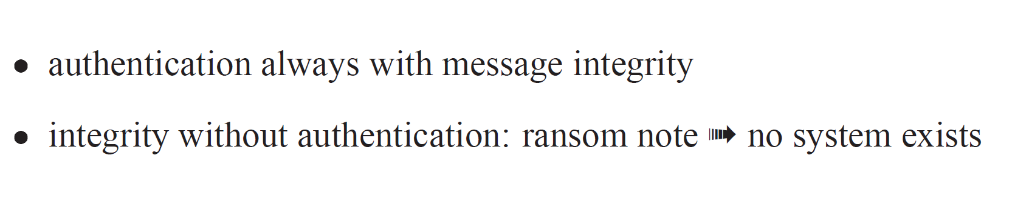
Message Integrity

Slide 30
Unit -3 Topics
Security Services for E-mail
Establishing keys
Establishing Public and secret keys
Privacy
End-to end Privacy, Privacy with distribution List Exploders
Authentication of the source
Based on public key technology and secret keys and with distribution list
Message Integrity
Non-repudiation
Introduction and Overviw of PGP
Efficient Encoding
Certificate and key revocation
Signature types, Private key, Fing types
Anomalies
Object Format
S/MIME

Slide 31
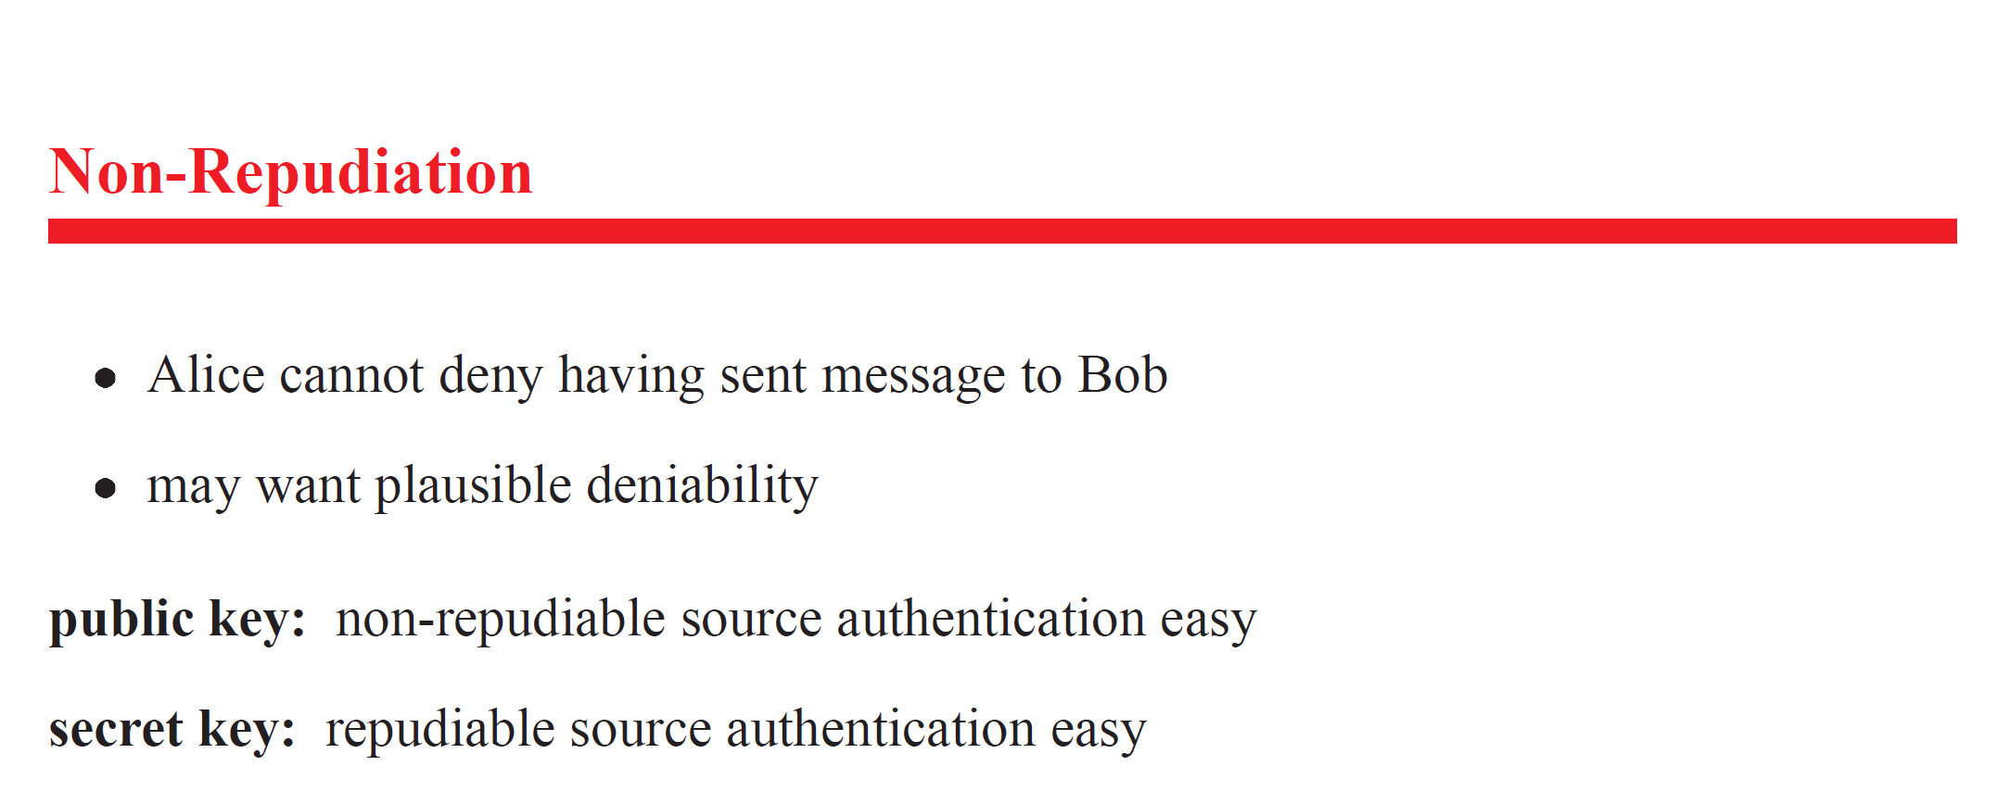
Non-repudiation

Slide 32
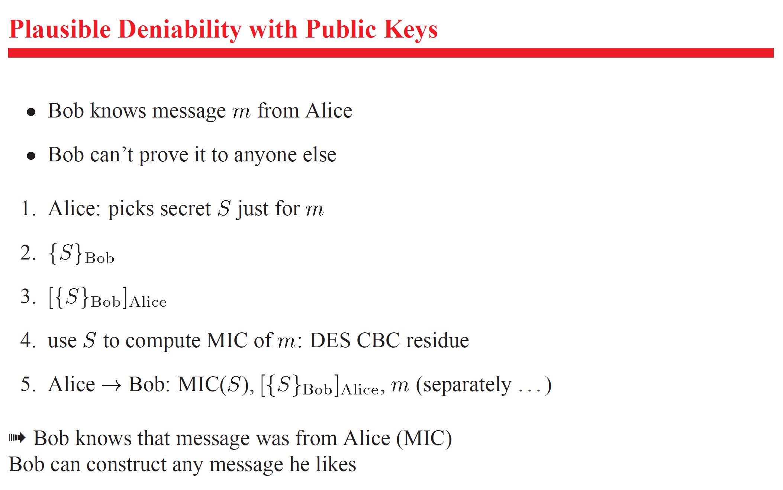
Plausible Deniability Based on Public Key Technology

Slide 33
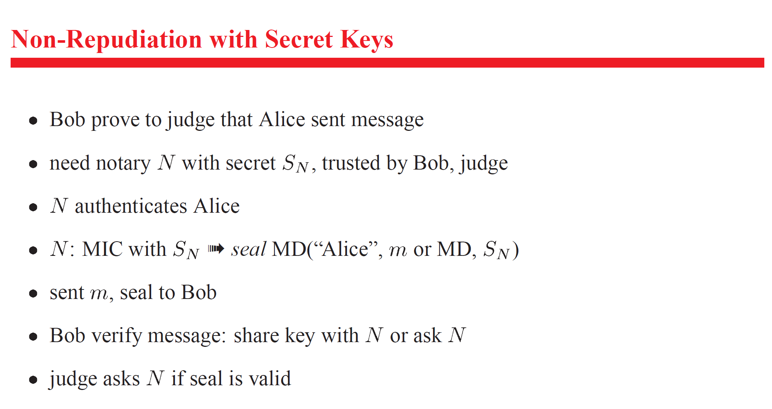
Non-Repudiation with Secret Keys

Slide 34
Unit -3 Topics
Security Services for E-mail
Establishing keys
Establishing Public and secret keys
Privacy
End-to end Privacy, Privacy with distribution List Exploders
Authentication of the source
Based on public key technology and secret keys and with distribution list
Message Integrity
Non-repudiation
Introduction and Overviw of PGP
Efficient Encoding
Certificate and key revocation
Signature types, Private key, Fing types
Anomalies
Object Format
S/MIME

Slide 35
Pretty Good Privacy(PGP)- Overview
Email security protocol invented by Phil Zimmermann.
PGP was designed to provide all four aspects of security, i.e., privacy, integrity, authentication, and non-repudiation in the sending of email.
PGP uses a digital signature (a combination of hashing and public key encryption) to provide integrity, authentication, and non-repudiation.
PGP uses a combination of secret key encryption and public key encryption to provide privacy. Therefore, we can say that the digital signature uses one hash function, one secret key, and two private-public key pairs.

Slide 36
Pretty Good Privacy-
Overview (contd)
PGP is an open source and freely available software package for email security.
PGP provides authentication through the use of Digital Signature.
It provides confidentiality through the use of symmetric block encryption.
It provides compression by using the ZIP algorithm, and EMAIL compatibility using the radix-64 encoding scheme.

Slide 37
Algorithms Supported by PGP
For asymmetric key encryption
RSA
DSS
Diffie-Hellman Key
For Symmetric Key Encryption
CAST-128
IDEA
DES-3
For Authentication
SHA-1

Slide 38
Steps taken by PGP to create secure e-mail at the sender site
The e-mail message is hashed by using a hashing function to create a digest.
The digest is then encrypted to form a signed digest by using the sender's private key, and then signed digest is added to the original email message.
The original message and signed digest are encrypted by using a one-time secret key created by the sender.
The secret key is encrypted by using a receiver's public key.
Both the encrypted secret key and the encrypted combination of message and digest are sent together.

Slide 39
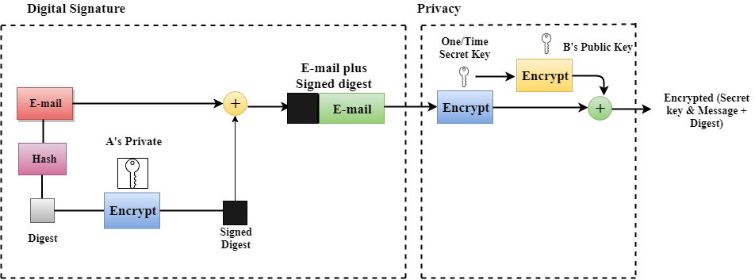
PGP at the Sender site (A)

Slide 40
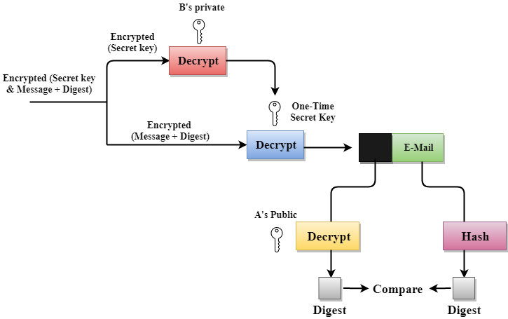
PGP at the Receiver site (B)

Slide 41
Unit -3 Topics
Security Services for E-mail
Establishing keys
Establishing Public and secret keys
Privacy
End-to end Privacy, Privacy with distribution List Exploders
Authentication of the source
Based on public key technology and secret keys and with distribution list
Message Integrity
Non-repudiation
Introduction and Overviw of PGP
Efficient Encoding
Certificate and key revocation
Signature types, Private key, Fing types
Anomalies
Object Format
S/MIME

Slide 42
Efficient Encoding
PGP allows you to specify , when handing a file to PGP to process , whether the file is text or binary.
If you tell PGP the file is binary , then PGP will not canonicalize it , and PGP will mark the PGP-processed message as binary so that the PGP at the receiver will know not to perform reverse canonicalization.
By merely marking the file this way , PGP manages to avoid ever needing two encodings on a single message.

Slide 43
Efficient Encoding
To conserve bits PGP compresses a file before sending it , whether it is binary or not.
PGP uses the utlity ZIP for compression.
50% compression achieved ; PGP need to do one expansion encoding after encrypting a file , what PGP actually has to transmit will often be smaller than the original file.

Slide 44
Unit -3 Topics
Security Services for E-mail
Establishing keys
Establishing Public and secret keys
Privacy
End-to end Privacy, Privacy with distribution List Exploders
Authentication of the source
Based on public key technology and secret keys and with distribution list
Message Integrity
Non-repudiation
Introduction and Overviw of PGP
Efficient Encoding
Certificate and key revocation
Signature types, Private key, Fing types
Anomalies
Object Format
S/MIME

Slide 45
Certificate and Key Revocation
Certificate can be revoked by whoever signed the certificate.
Current custom in PGP is to issue non – expiring certificates (by omitting the VALIDITY PERIOD field).

Slide 46
Certificate and Key Revocation
Key can be revoked too. Revoked only by the owner .
Owner will issue a key revocation only if felt someone has discovered owners private key / stolen owner’s private key .

Slide 47
Certificate and Key Revocation
Key and certificate revocations are distributed informally, just as are public keys and certificates.
There are public servers where you can post and search for certificates.

Slide 48
Unit -3 Topics
Security Services for E-mail
Establishing keys
Establishing Public and secret keys
Privacy
End-to end Privacy, Privacy with distribution List Exploders
Authentication of the source
Based on public key technology and secret keys and with distribution list
Message Integrity
Non-repudiation
Introduction and Overviw of PGP
Efficient Encoding
Certificate and key revocation
Signature types, Private key, Fing types
Anomalies
Object Format
S/MIME

Slide 49
Signature Types
For each signed quantity , PGP indicates whether what is being signed is a message or a certificate .
It’s a good practice whenever a key can be used for multiple things to explicitly say what kind of thing is being processed . This avoids any possibility of aliasing .

Slide 50
YOUR PRIVATE KEY
To verify signatures on signed messages , you don’t need a private key .
To sign your own messages , or if you want to receive encrypted PGP mail , you need a private key.
- PGP will generate private key for you and you can specify the size of the key .

Slide 51
PGP – Key Rings
A key ring is a data structure you keep that contains some public keys , some information about people , and some certificates .
PGP users Sharing key ring information provides a quick method of building up your database of public keys.

Slide 52
PGP – Key Rings
PGP allows you to assert how much trust you place on different people.
There are 3 levels of trust : None , Partial or Incomplete .
PGP computes the trust that should be placed on certificates and public keys in your key ring based on the trust information you asserted on the people.
A certificate signed by someone you indicated you don’t trust at all will be ignored.
Whom or what you trust is a very private decision.

Slide 53
Unit -3 Topics
Security Services for E-mail
Establishing keys
Establishing Public and secret keys
Privacy
End-to end Privacy, Privacy with distribution List Exploders
Authentication of the source
Based on public key technology and secret keys and with distribution list
Message Integrity
Non-repudiation
Introduction and Overviw of PGP
Efficient Encoding
Certificate and key revocation
Signature types, Private key, Fing types
Anomalies
Object Format
S/MIME

Slide 54
Anomalies
Anomalies associated with
File Name
People Names

Slide 55
Anomalies
PGP recommends that the user identification string contains a little more information than just the name of the user , for instance , the user’s email address .
PGP recommends including Internet email addresses in the name.

Slide 56
Unit -3 Topics
Security Services for E-mail
Establishing keys
Establishing Public and secret keys
Privacy
End-to end Privacy, Privacy with distribution List Exploders
Authentication of the source
Based on public key technology and secret keys and with distribution list
Message Integrity
Non-repudiation
Introduction and Overviw of PGP
Efficient Encoding
Certificate and key revocation
Signature types, Private key, Fing types
Anomalies
Object Format
S/MIME

Slide 57
Object Formats
PGP reads and writes a variety of objects .
Objects may contain a variety of fields , and some objects contain other objects.

Slide 58
Object Formats
Each object can be represented in two formats .
Compact
SMTP mailable

Slide 59
Object Formats
The SMTP mailable format is computed from the compact format by performing encoding and adding a human-readable header and trailer so that a human will know the cyber crud between the header and trailer needs to be processed by PGP.

Slide 60
Object Formats
The human – readable header is
-----BEGIN PGP MESSAGE -----
Version 2.2
The Human – readable trailer is
-----END PGP MESSAGE -----

Slide 61
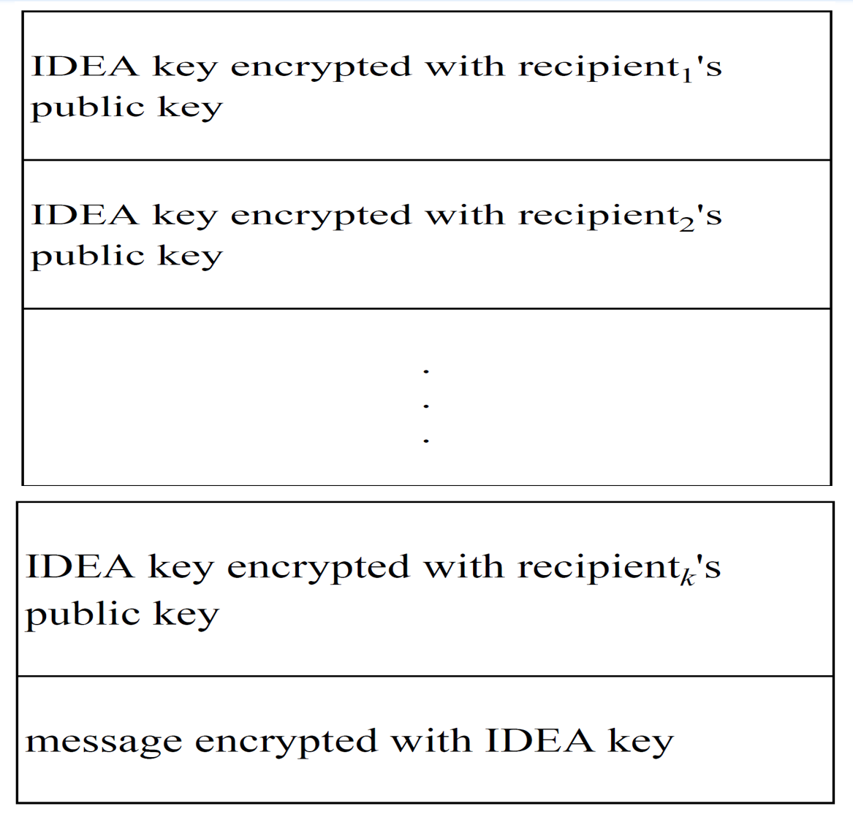
Message Formats – Encrypted Message

Slide 62
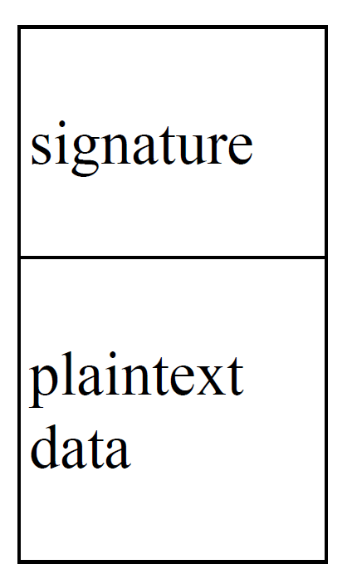
Message Formats – Signed Message
Signed Message : This is likely to be COMPRESSED DATA . When uncompressed , the result is

Slide 63
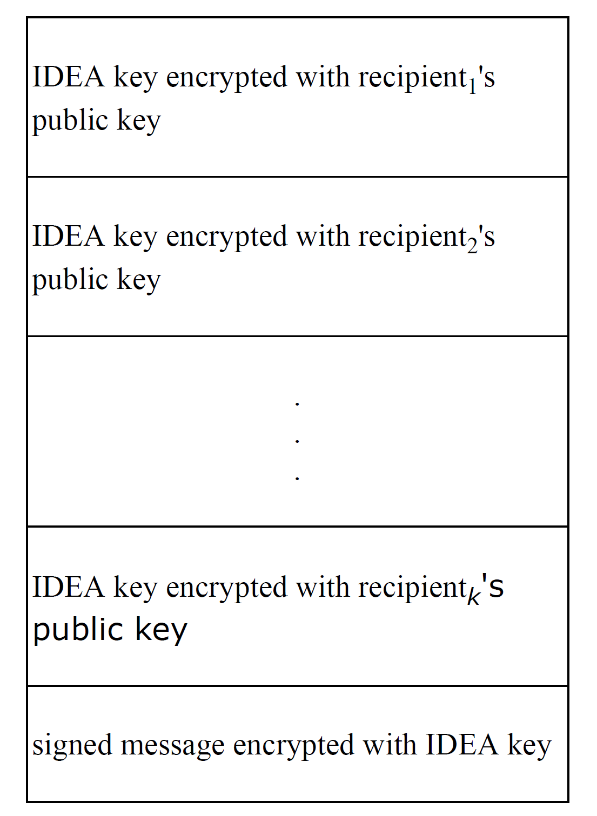
Message Formats – Encrypted Signed Message

Slide 64
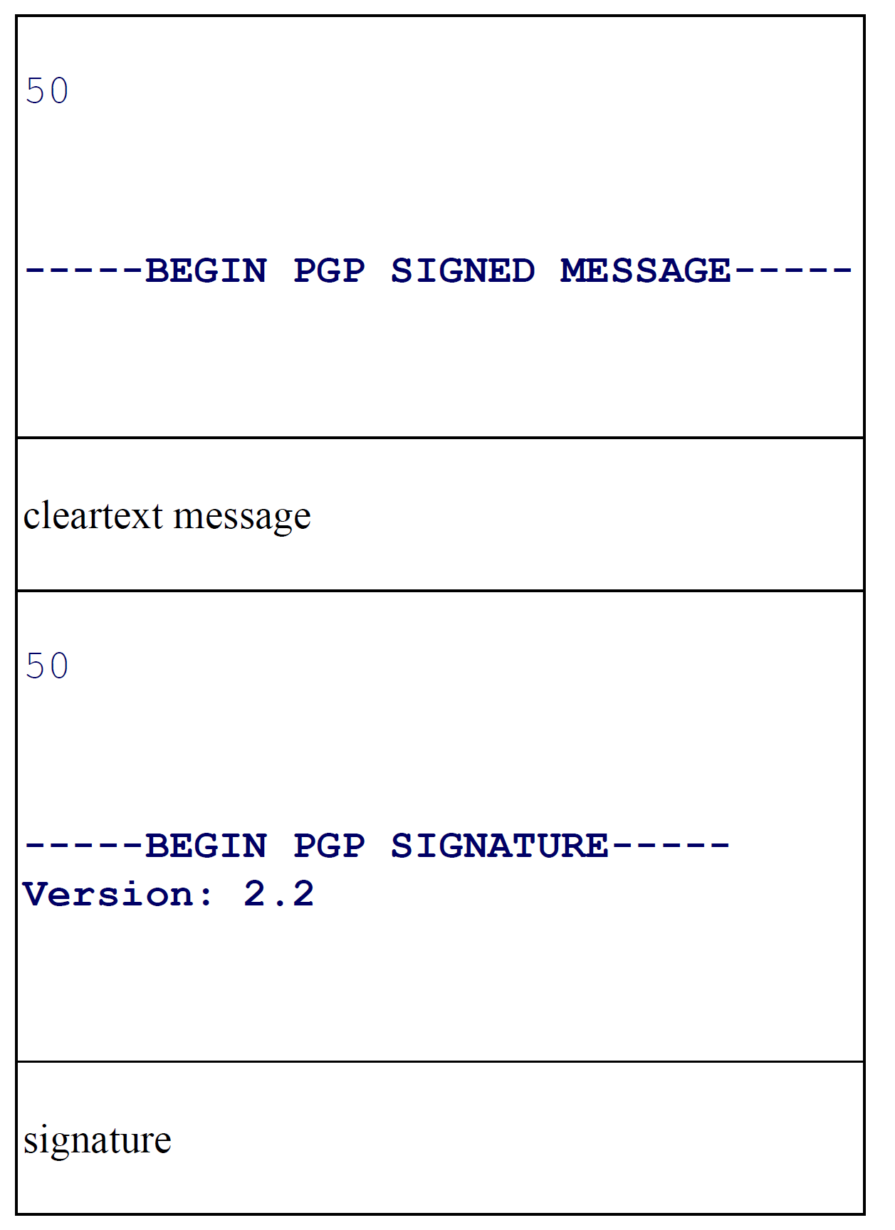
Message Formats – Signed Human-Readable Message

Slide 65
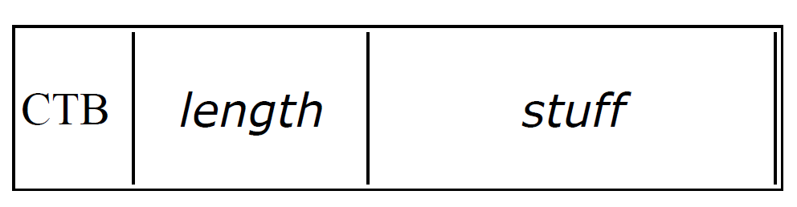
Primtive Object Formats
Primitive object formats are
CTB stands for cipher type byte and specifies the PGP object type and the length of length.
Certain object types contain one or more integers in their stuff field.
Integers are encoded as a length in bits (two octets, most significant first) followed by the binary integer with leading 0 bits to pad to a multiple of 8 bits then packed into octets most significant first

Slide 66
Unit -3 Topics
Security Services for E-mail
Establishing keys
Establishing Public and secret keys
Privacy
End-to end Privacy, Privacy with distribution List Exploders
Authentication of the source
Based on public key technology and secret keys and with distribution list
Message Integrity
Non-repudiation
Introduction and Overviw of PGP
Efficient Encoding
Certificate and key revocation
Signature types, Private key, Fing types
Anomalies
Object Format
S/MIME

Slide 67
Secure/Multipurpose Internet Mail Extension (S/MIME)
S/MIME is a security-enhanced version of Multipurpose Internet Mail Extension (MIME).
In this, public key cryptography is used for digital sign, encrypt or decrypt the email.
User acquires a public-private key pair with a trusted authority and then makes appropriate use of those keys with email applications.

Slide 68
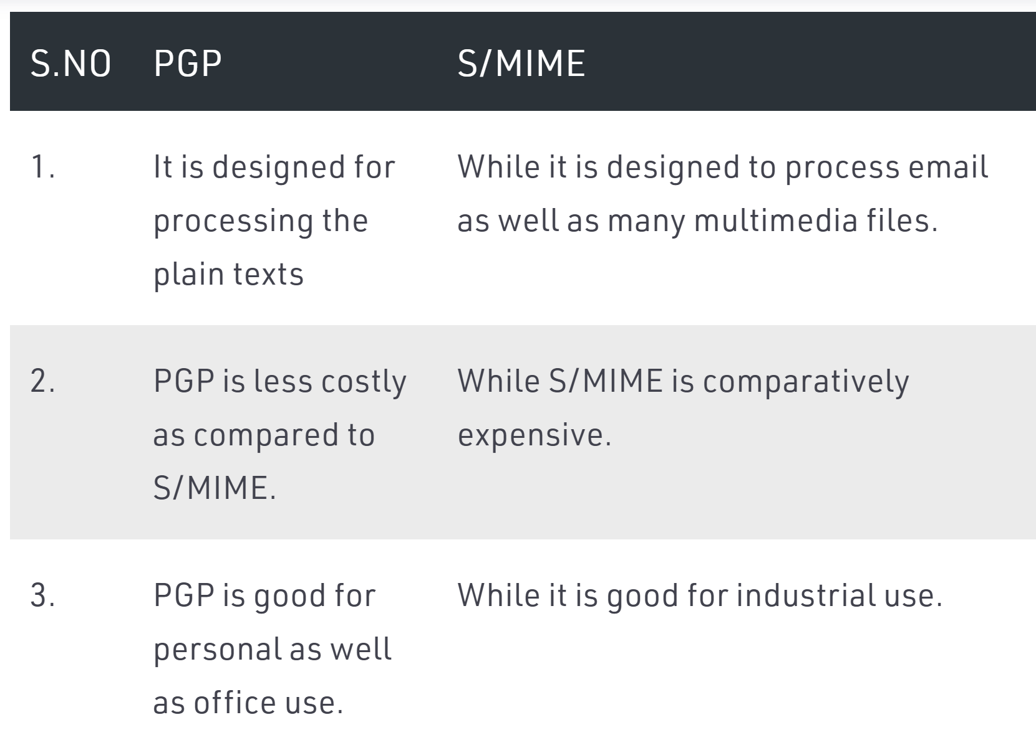
Difference between PGP and S/MIME

Slide 69
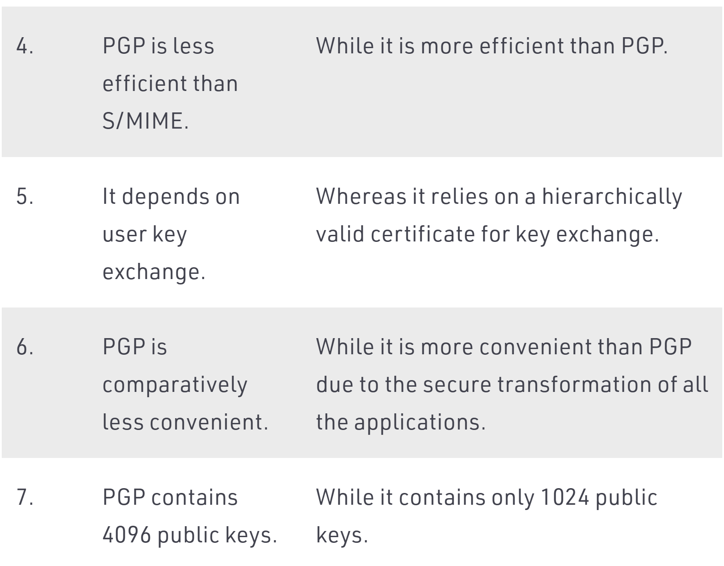
Difference between PGP and S/MIME

Slide 70
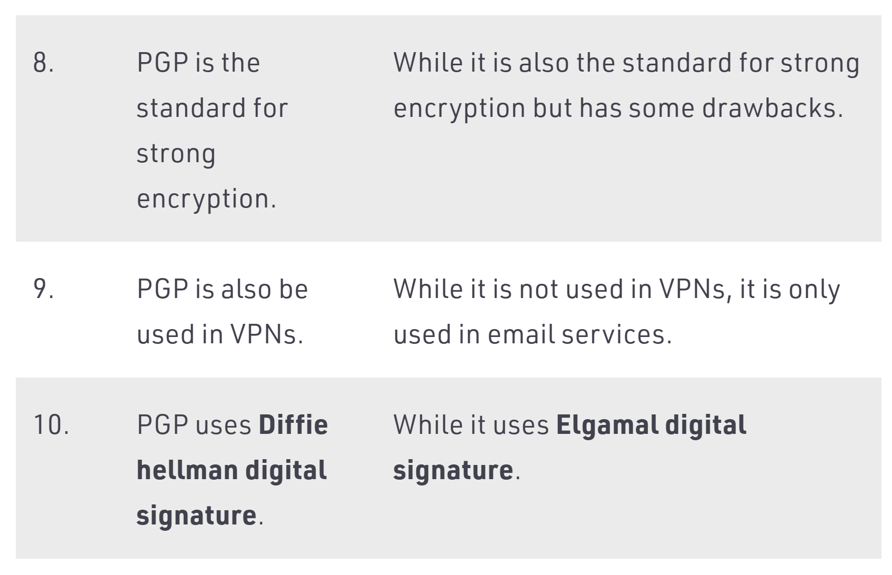
Difference between PGP and S/MIME

Slide 71
END UNIT - 3

